Slide 1
Project Management:
Process, Technology, and Practice
Ganesh Vaidyanathan
Chapter 6
Risk Management

Slide 2
Learning objectives
Identify project risks
Determine quantitative or qualitative value of project risks and prioritize them
Propose plans to mitigate such risks
Monitor and control the risks
Manage projects by lowering internal and external risks

Slide 3
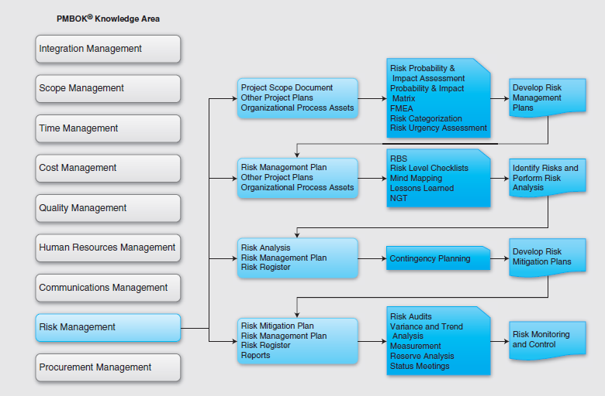

Slide 4
Risk
Risk is
a function of the likelihood of a given threat and the resulting impact of that adverse event on the organization.
an uncertain event, and if that event occurs, there will be a positive or negative effect on the objectives of the project.
If one drives fast, there is a risk of getting a speeding ticket―a cost that is involved. Worse still, there is a risk of getting into an accident―a life may be in jeopardy.
In general, risk is considered to be negative to the value of a project.
Risks in projects are defined as undesired events that may cause increased scope, delays, and spending, problems due to resources, unsatisfactory performance, and decreased value.

Slide 5
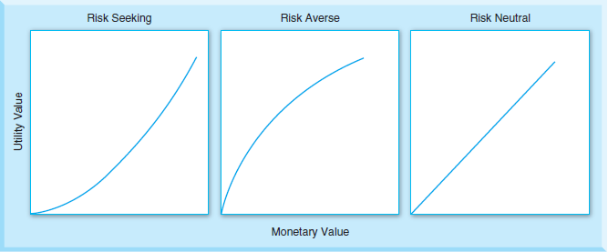
Risk Identification
Risk averse decision-makers
Risk seeking decision-makers
Risk neutral decision-makers

Slide 6
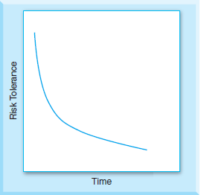
Specific to firms
Upper management must ensure that project managers understand their project’s role within the context of organizational risk.
Because organizations have limited resources and many projects competing for these scarce resources, they ask project managers not to be overly optimistic in their estimates and forecasts.
Bad decisions can lead to risks that result in project delays, late finish dates, budget overruns, and unmet project goals.

Slide 7
Specific to project managers
A lack of understanding of risk on the part of management or a project manager’s wrong perceptions of management’s understanding of risks can lead to serious problems in projects.
Project managers may feel that by exposing risks they themselves may be at risk and that management may suggest more control of the risks than necessary.
A project manager’s risk tolerance depends heavily on the visibility of a project.
A project manager may accept more risk if a project is highly visible as success will bring rewards.
If the project is small and not that visible, taking risks may not be lucrative, and PMs may take fewer risks.

Slide 8
Specific to project managers
Identifying and assessing risks will compel project managers to make better decisions.
While it is great to have a timeline and an agreed-upon date, risk management means that the project manager and upper management need to have realistic expectations of the people who will be doing the work.

Slide 9
Specific to stakeholders
When a client and contractor lay out project goals, risk tolerances of both the client and the customer have to be defined.
Identified risks enable stakeholders of a firm to manage issues accordingly and be ready to exploit opportunities.
If a stakeholder possesses some information and does not share it with a project manager, the performance of the project will suffer as there may be risks associated with their actions.

Slide 10
Risk Breakdown Structure
Level 0 | Level 1 | Level 2 | Level 3 </TBL_COLHD>
Project Risk | Management | Corporate | Organizational stability
 |  |  | Financial stability
 |  | Stakeholders | History and culture
 |  |  | Financial stability
 |  |  | Requirements definitions and scope
 | External | Cultural | Cultural issues
 |  |  | Political, legal, regulatory issues
 |  |  | Interest groups, lobbyist issues
 |  | Economic | Labor market
 |  |  | Labor conditions
 |  |  | Financial markets

Slide 11
Internal and External Risks
Internal risks
Internal risks can be controlled by project managers and stakeholders.
They originate from all phases of a project.
Examples of internal risks are not meeting time, cost, scope, performance and value of a project due to technological difficulties.
Internal risks occur due to failure in customer relationships. These may be due to failure in key success factors of a project.

Slide 12
Internal and External Risks
External risks
These risks are from sources outside the project.
Project managers or stakeholders have little or no control over these risks.
Physical risks encompass damage by fire, flood, or other catastrophe, computer virus that infects the development environment or operational system, and a team member who steals confidential project material and makes it available to competitors.

Slide 13
Tools and techniques to identify risks
Risk Source | Risk Level
No of system modules
Less than 10 | None
10-20 | Low
21-30 | Medium
More than 30 | High
No of System Components
0-3 | None
3-6 | Low
7-10 | Medium
More than 11 | High
Brainstorming
Cause-and-effect diagrams
Checklists
Nominal Grouping Technique
Mind mapping
Delphi technique
Lessons learned from similar projects

Slide 14
Risk assessment
Risk assessment is the determination of the quantitative or qualitative value of the risks in a project.
Qualitative risk analysis
Each risk is defined by a set of standard parameters including likelihood or probability, severity or impact, detection process, and mitigation plans.
Quantitative risk analysis
Help a project manager determine the probability that a project will be completed on time and within a budget
Identify critical project parameters that affect project schedule the most, determine project success rate, and make decisions about viable project alternatives

Slide 15
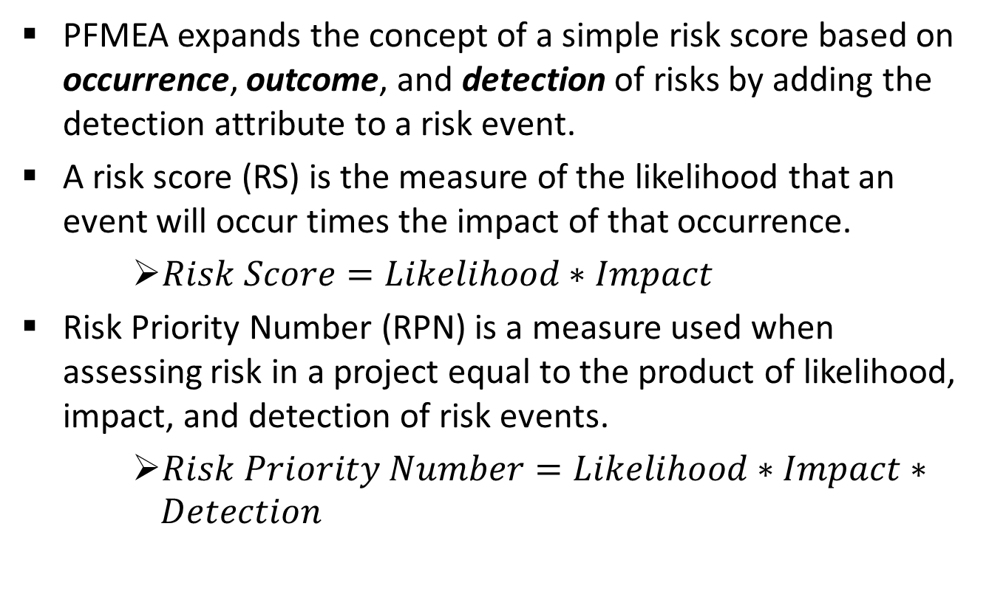
PFMEA

Slide 16
PFMEA: Process Failure Mode Effects Analysis
RPN (Risk Priority Number) is a measure used when assessing risk in a project. Larger RPN values normally indicate more critical failure modes or risks.
Any risk that has an effect resulting in an impact of 9 or 10 would have a top priority to control and mitigate. Impact is given the most weight when assessing risk.

Slide 17
FMEA
Risk ID | Risks | Occurrence | Outcome | Detection | RS | RPN
1 | Will the products be delivered? | 7 | 8 (schedule) | 4 | 56 | 224
2 | How will the quality of products be? | 8 | 10 (quality) | 6 | 80 | 480
3 | How good is the technical capability? | 4 | 10 (schedule) | 10 | 40 | 400
4 | How is financial stability? | 4 | 3 (schedule) | 3 | 12 | 36
5 | Will our IP be protected? | 2 | 1 (schedule) | 4 | 2 | 8

Slide 18
Risk Rating
Rating | Description | Detail
A | Highly Likely | Almost 100% probability in 12 months
B | Likely | Between 10% and 100% probability in next 10 years
C | Possible | Between 1% and 10% probability in next 100 years
D | Unlikely | Less than 1% probability in next 100 years

Slide 19
Risk Rating
Rating | Description | Detail
1 | Marginal | Facility can provide a normal level of service
2 - 4 | Serious | Facility can provide a normal level of service with assistance from local community
5 - 7 | Critical | Facility can provide a normal level of service with assistance from local as well as outside communities
8 - 10 | Catastrophic | Facility cannot provide services

Slide 20
Risk Rating
 | Marginal | Serious | Critical | Catastrophic
High likely | A1 | A2-A4 | A5-A7 | A8-A10
Likely | B1 | B2-B4 | B5-B7 | B8-B10
Possible | C1 | C2-C4 | C5-C7 | C8-C10
Unlikely | D1 | D2-D4 | D5-D7 | D8-D10

Slide 21
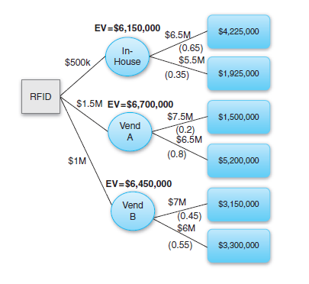
Decision Trees
Inventory control project in a manufacturing environment budgeted at $5M with a total risk impact of $1M. Vendor-A is ready to implement the RFID system for $1.5M with a failure probability of 20%. Vendor-B is willing to implement a similar system for $1M with a failure rate of 45%. The project manager estimates that if the in-house project team implements the system, the failure probability will be 65% for $500K.

Slide 22
Risk Response Planning
Transfer the risk
Avoid the risk
Reduce the risk
Have contingency plan
Accept risk

Slide 23
Risk mitigation techniques: Scope
Define the needs of each task clearly
Specify customer or user acceptance requirements clearly
Include the customer’s true requirements and eliminate wishes and needs
Establish a clear change management process including impact assessment of such changes
Know the involved technology well before project commitment
Build a prototype or model
Test products or systems with users often to uncover problems and manage expectations
Define the deliverables clearly

Slide 24
Risk mitigation techniques: Scope
Define the deliverables clearly
Design a complete and thorough WBS to include all tasks
Anticipate defects in materials, service offerings, products, systems, software, or hardware
Anticipate defects and problems during integration
Anticipate defects in dependent tasks, products, systems, and services
Plan well to reduce defects and problems

Slide 25
Risk mitigation techniques: Schedule
Create a project schedule and strive to adhere to it
Schedule the most risky tasks as early as possible to allow time to recover from failure
Monitor critical and near-critical activities very closely
Employ the best team members on critical tasks
Allow and provide incentives for overtime work
Schedule high-risk tasks and activities parallel to low-risk projects
Allow enough planning time for the anticipated defects and problems

Slide 26
Risk mitigation techniques: Schedule
Communicate often to warn stakeholders much ahead of time about potential schedule problems
Show urgency and make sure that others understand the urgency of the problem
Set deadlines and make sure to achieve those deadlines
Track project progress, collect measurements, analyze, and take action
Be conservative and allow contingency reserve or buffer time for high-risk activities

Slide 27
Risk mitigation techniques: Cost
Consider many design alternatives before choosing the design
Identify and monitor the key cost drivers
Identify critical tasks and their interdependencies
Redo all cost estimations when doing rework
Choose low-risk technologies
Use feasibility studies to understand the cost involved in a project
Use a proven method for realistic basis for cost estimations

Slide 28
Risk mitigation techniques: Cost
Use proven technology and “commercial off-the-shelf” equipment, products, systems, or software
Use prototyping before the implementation of the actual project to better understand the costs

Slide 29
Risk mitigation techniques: Resources
Align best individuals with the requirements to complete a task
Assign staffing to all tasks and leaving no task unassigned
Understand commitment levels of all resources
Understand the role, responsibility, accountability, reliability, and authority of each project team member
Establish teamwork and trust among team members
Anticipate staff deficiencies long before they can cause delays
Collect and analyze resource measurements to detect problems early
Reward the right people

Slide 30
Risk mitigation techniques: Performance
Decide based on data, good decisions models, and technical parameters
Provide the project with adequate training and incentives
Use experts to assess project progress and performance
Perform extensive tests, research, and evaluations
Employ the best technical team

Slide 31
Risk mitigation techniques: Value
Decide based on data, good decisions models, and technical parameters
Provide the project with adequate training and incentives
Use experts to assess project progress and performance
Perform extensive tests, research, and evaluations
Employ the best technical team

Slide 32
Contingency Planning
Contingency planning is a systematic approach to identify what can go wrong in a project.
A project manager can identify contingency events and be prepared with plans, strategies and approaches to mitigate and manage risks.
The objective of contingency planning is not to identify and develop a plan for every possible contingency.
The objective is to encourage a project manager to think about major contingencies and possible responses once the risks are identified and quantified.

Slide 33
Risk Management
The prime objective of risk management is to minimize the impact and probability of the occurrence of risks in organizations.
Risk monitoring and control is a process in place to keep track of the identified risks, identify new risks, monitor both external and residual risks, ensure the execution of risk plans, and evaluate the effectiveness of the risk plans in reducing risk.

Slide 34
Risk Management
It is also required in order to monitor trigger conditions for contingencies and update organizational process assets at regular periods.
Triggers are indications that a risk has occurred or is about to occur.
Triggers may be discovered either during the risk identification process or during the monitoring and controlling process.

Slide 35
Risk Management
Triggers are risk symptoms or warning signs. The purpose of risk monitoring is to determine if:
Risk responses have been executed as per plans.
Risk responses are effective as expected.
New risks have occurred.
New risk responses should be identified and developed.
All policies are followed.

Slide 36
Risk Monitoring and Control
Inputs
Risk management plan
Risk register
Work performance information
Performance reports
Tools and techniques
Risk assessment
Risk audits
Variance and trend analysis
Technical performance measurement
Reserve analysis
Status meetings
Outputs
Risk register updates
Organization process assets updates
Change requests
Project management plan updates
Project document updates

Slide 37
Risk Register or Logs
Risk Category | Risk | Occurrence | Outcome | Detection | RS | RPN | Mitigation | Contingency | Action By
Delivery | Will the products be delivered? | 6 | 6 | 2 | 36 | 72 | Effective communications | Plan visits to supplier | Ron
Quality | How will the quality of products be? | 6 | 8 | 6 | 48 | 288 | Help suppliers with good quality programs | Send a quality expert to help supplier | Jane

Slide 38
Summary
A risk is an uncertainty such as the possibility of project failure or of not meeting scope, cost, schedule, resource constraints, performance factors, or estimated value of a project.
Risks can be external, internal, positive, negative, or residual.
Risk management consists of the identification of risks, the assessment of the value of these risks, the proposed plans to mitigate these risks, the monitoring of the risks, and the control of the risks.
Risks may be identified by project managers and the stakeholders of a project depending on their acceptable risk tolerance.

Slide 39
Summary
Project managers or organizations can be viewed as risk averse, risk seeking, or risk neutral.
A structured methodology to identify risks in projects is the Risk Breakdown Structure (RBS) where risks can be categorized and structured to provide a standard presentation of project risks.
The most common tools and techniques used for developing a list of project risks are brainstorming, cause-and-effect diagram, checklists, Nominal Grouping Technique, mind mapping, Delphi technique, and lessons learned from similar projects.

Slide 40
Summary
Risks can be assessed either qualitatively or quantitatively.
In qualitative risk management, each risk is defined by a set of standard parameters including likelihood or probability, severity, impact, detection process, and mitigation plans. Using this framework used by many industries, a method to assess risks qualitatively, PRMEA, is provided in this section.
Qualitative risk assessment may be accomplished by risk probability and impact assessment, probability and impact matrix, risk data quality assessment, risk categorization, risk urgency assessment, and expert judgment.

Slide 41
Summary
Quantitative risk analysis will help a project manager to determine the probability of a project that will be completed on time and within budget and provide value.
Quantitative risk assessment may be accomplished by many methods including quantitative risk analysis, data gathering and representation techniques, simulation and modeling techniques, and expert judgment.

Slide 42
Summary
Risk responses are actions to mitigate risks and reduce project threats. Risk responses include the identification and assignment of a risk owner whose responsibility it is to take ownership of agreed-upon risk responses. Risk responses are planned for each risk and must be effective to mitigate identified risks.
Once the risks are assessed, risk planning with risk responses can be accomplished by methods including risk transfer, risk avoidance, risk reduction, or risk acceptance.
Risk monitoring and control is a process to manage risks in a project.

Slide 43
Summary
Risk management that includes monitoring and controlling risks should be a part of project management.
There are tools and techniques that are available to help project managers monitor and control risks in projects including risk assessment, risk audits, variance and trend analysis, technical performance measurement, and reserve analysis.

Slide 44
Class Discussions
Differences and similarities between risks in projects and project portfolios.
Risks are difficult to identify in a project.
Once all risks are identified, it is a good practice to constrain the project using those risks.
Risk management is proportional to project complexity.
New technology components pose the same risk in projects as proven technologies.
Avoiding risks is better than either transferring or reducing risks.
Never avoid any risks in a project.

Slide 45


